Slide 1

163 MLK Jr. Drive
PO Box 505
Winder, GA 30680
678.425.6960 Office
770.868.0675 TDD
770.307.0126 Fax
www.winderhousing.com

Slide 2

Homebuyers Club
Workforce Wednesday
GED Classes
Citizenship Classes
Internships
Community Garden
Community Library
On-Site Health and Nutrition Services
On-Site Boys & Girls Club
Programs made
available through
Winder Housing Authority

Slide 3

Homebuyer Club
The Homebuyers Club is open to all residents of Winder Housing Authority. The purpose of the club is encourage residents to buy a home of their own. Classes include a variety of resources to create the ultimate self-paced home buying experience.
Topics covered: credit counseling, budget management, prequalifying, obtaining a mortgage, selecting a home, maintaining a home, and keeping your home.

Slide 4
Winder Housing Authority in Partnership with NEGRC WIOA Workforce Development Presents:
Workforce Wednesday
Held every third Wednesday from 9:00am until 12:00pm
Assistance with:
Resume Writing
Job Search/Referrals
Interviewing Skills
Georgia Work Ready Certification
Tuition Assistance

Slide 5


GED Classes
GED Classes offered thru Lanier Technical College. Classes consist of individualized test preparation on the five main topic areas:
    Math
    Reading
    Writing
    Social Studies
    Science

Slide 6
Citizenship Classes
Civics and American history instruction prepare
non-citizens to take the American citizenship test. Instruction covers the Constitution, American government, American customs, and historical events.

Slide 7

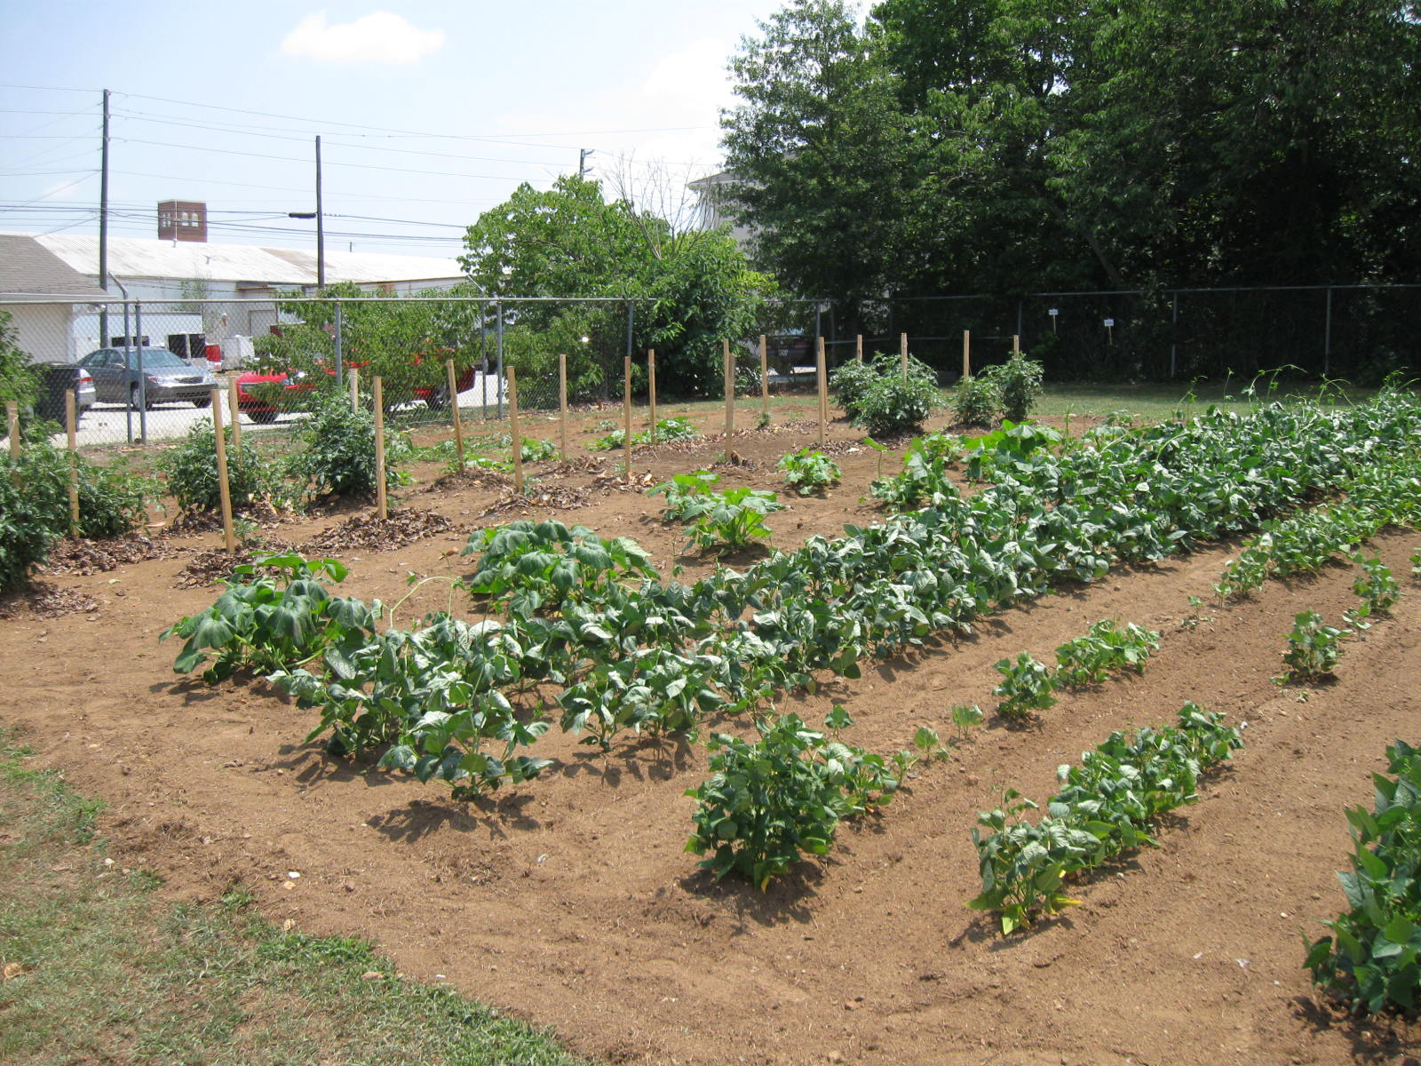
Community Garden
A Community Garden in two locations produce vine ripened tomatoes, garden sweet corn, tender collard greens, and much, much more.

Slide 8


Community Library
Yes! Winder Housing Authority has its very own community library. Whether you like reading fiction or non-fiction, horror or romance, you’re sure to find something that sparks your interest here at the
WHA Community Library.

Slide 9


PLUS…… an onsite
Boys & Girls Club
A POSITIVE PLACE TO GO
The Boys and Girls Club of Winder-Barrow has several programs that strive to help youth with academic success, healthy lifestyles and character and leadership development.
GREAT FUTURES START HERE!

