Slide 1



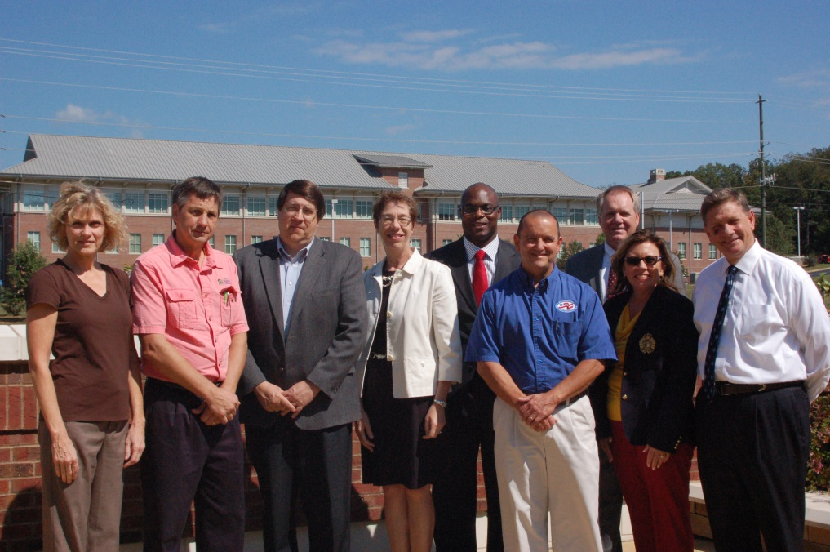

Winder Housing Authority Presents
GICH Harvest

Slide 2
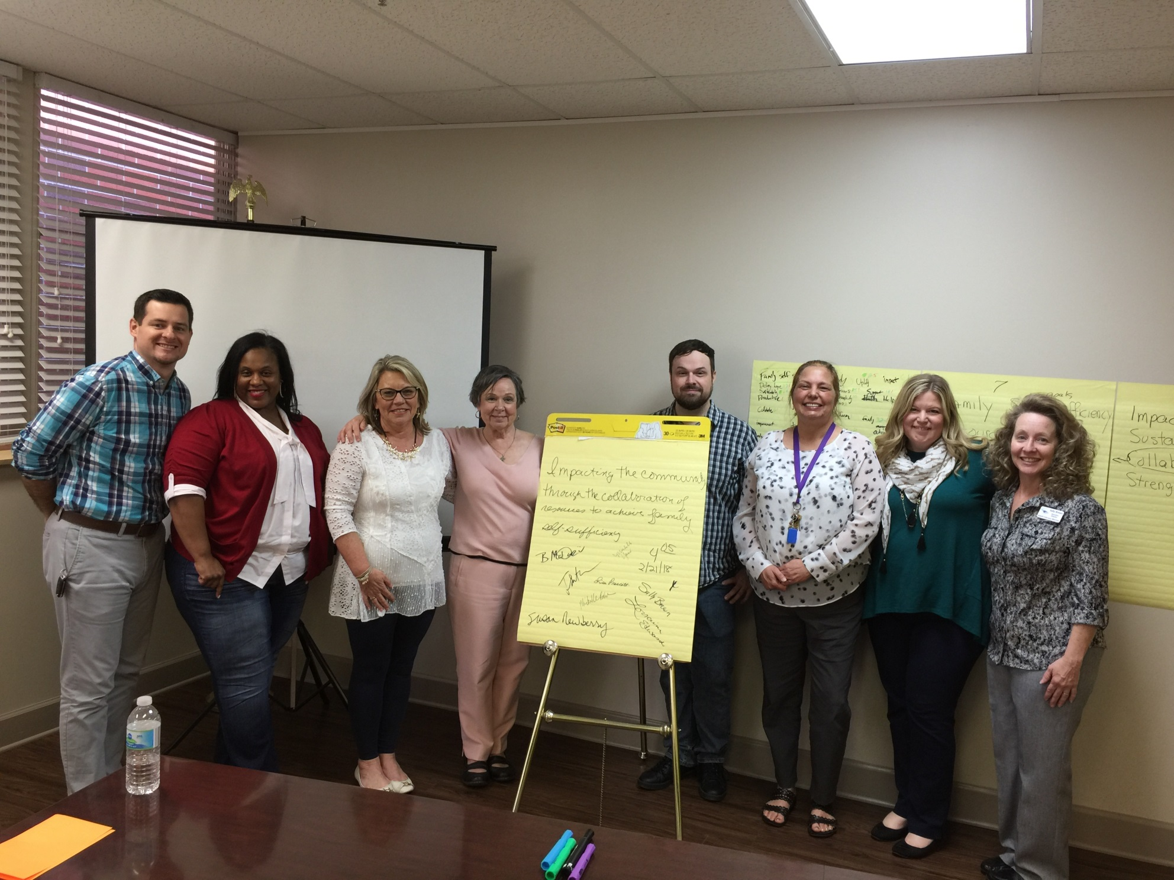
Michelle Yawn, Winder Housing Authority Executive Director and Winder GICH Team leader “GICH opened doors for our community by demonstrating the possibilities in true collaboration while benefiting and appreciating the value of each player in your community”.

Slide 3
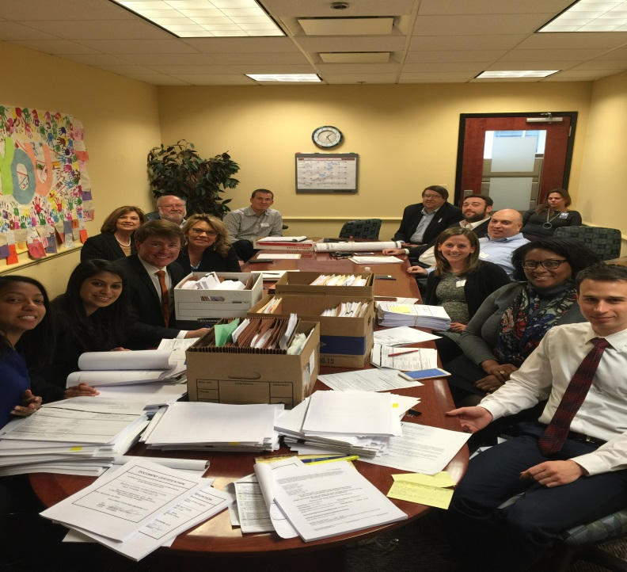

From Seeds to Harvest
2013 adoption of Urban Redevelopment Plan plants seeds for redevelopment of distressed neighborhoods
2015 Rental Assistance Demonstration (RAD) germinates as game changer in affordable housing
Wimberly Center for Community Development blooms

Slide 4
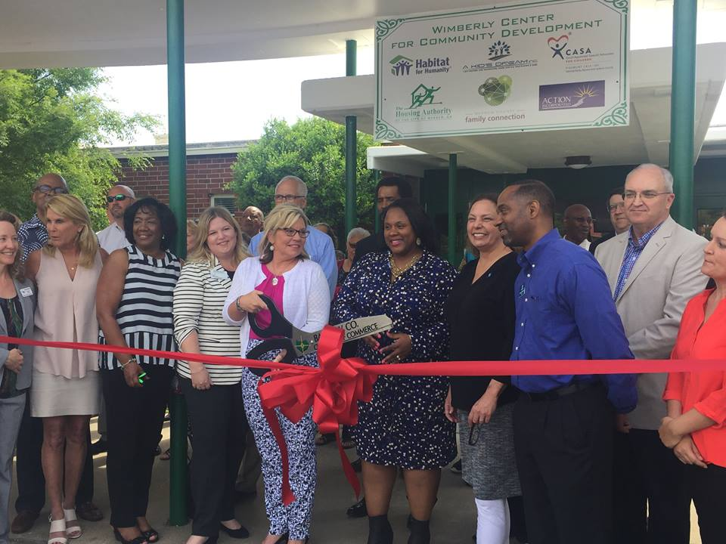

The Wimberly Center for Community Development
“Impacting the community through the collaboration of resources to achieve family self-sufficiency”

Slide 5
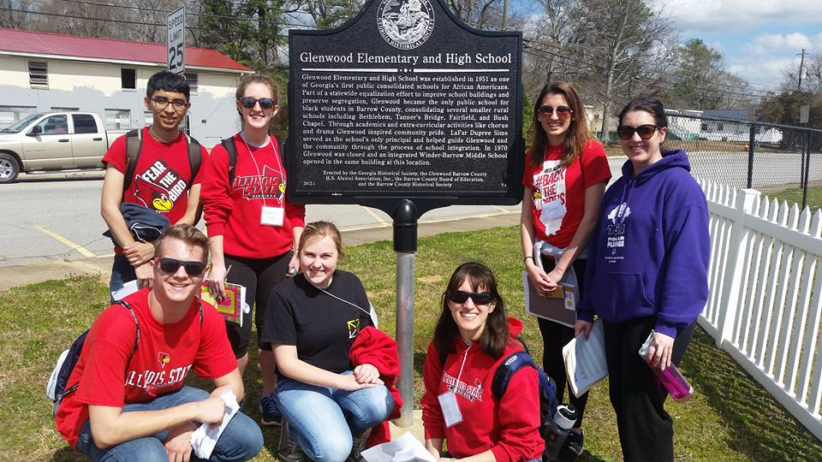
Initial Cross-Pollination of Funds
WHA provides $1MM acquisition funds and $1.5MM renovation funds from RAD Sales Proceeds
$500,000 CDBG 2014 Grant
Private foundation funds $250,000
Incredible volunteers

Slide 6
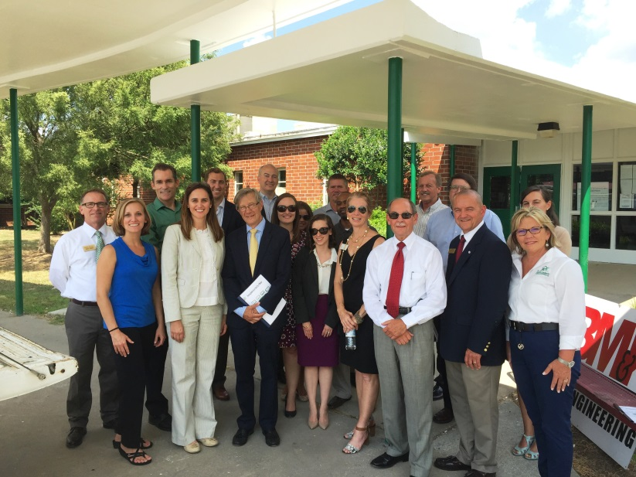
Local Foods Local Places (LFLP)Winder Germinates New Possibilities for
Wimberly Center
Technical assistance from six state & federal partners addressing food desert, blighted neighborhood
Birthed the idea of demonstration kitchen and community/production garden

Slide 7
Local Foods Local Places (LFLP)Winder Germinates New Possibilities for
Wimberly Center
ARC awards $203,000 to support kitchen/garden
Wimberly’s Roots non-profit forms
UGA partners with Wimberly on Business Plan, Community Garden Guide and Master Landscape/Garden Plans

Slide 8

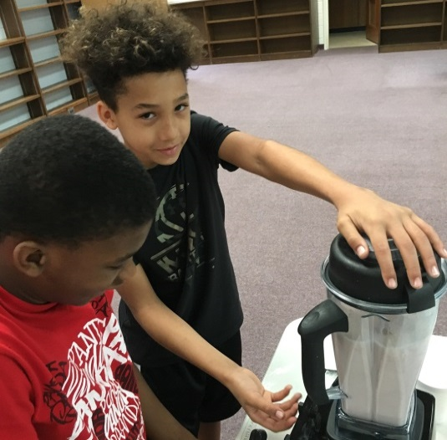
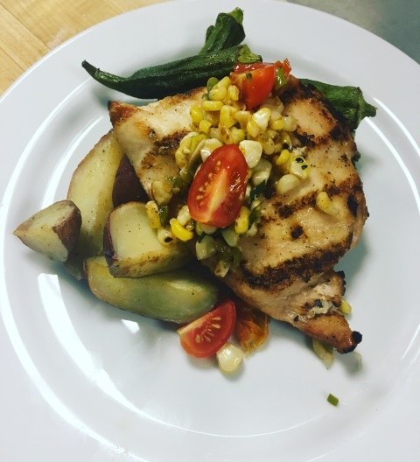

Cooking Classes
Healthy Meals
Catering
As well as :
Nutrition classes
Demonstration kitchen
On site and off site catering
Fresh produce stand
“Farm To School” production farm and fundraising

Slide 9
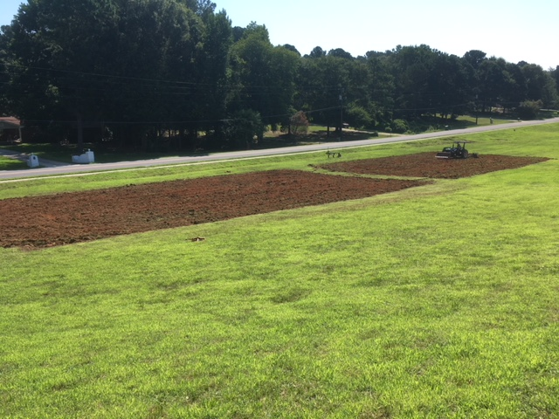
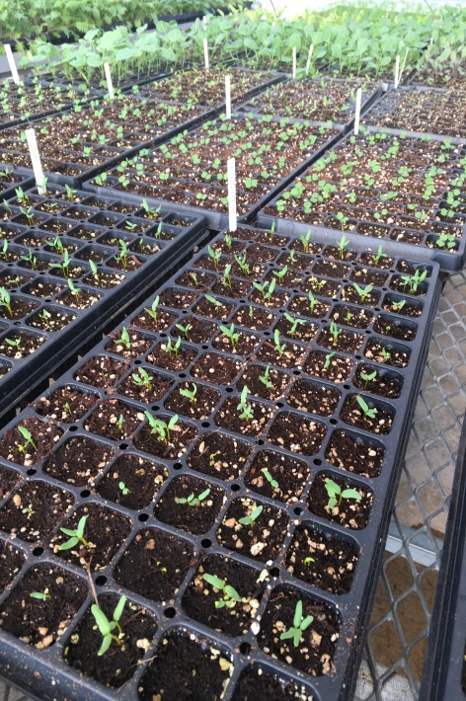
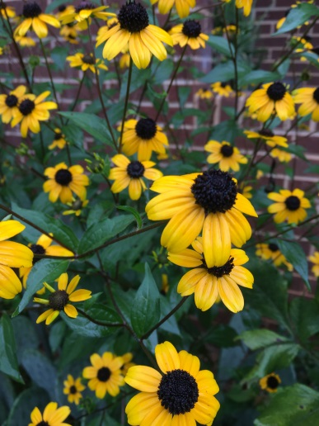
Community
Garden
The garden provides nutritious food to residents where access to this food is currently limited. Additionally, people will gain the skills needed to grow their own gardens and supplement their
diets with food they grow.

Slide 10


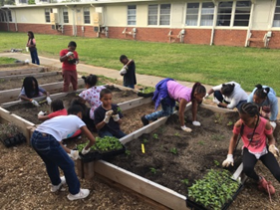
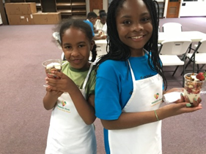

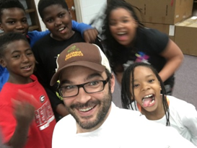
Boys & Girls Club Revel in the garden and kitchen

Slide 11

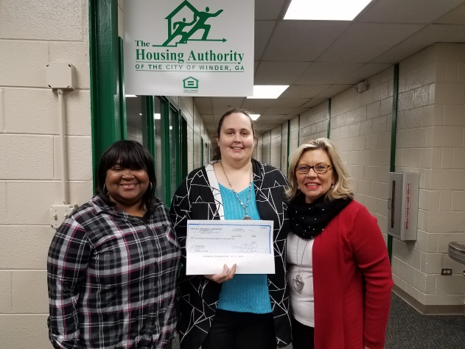
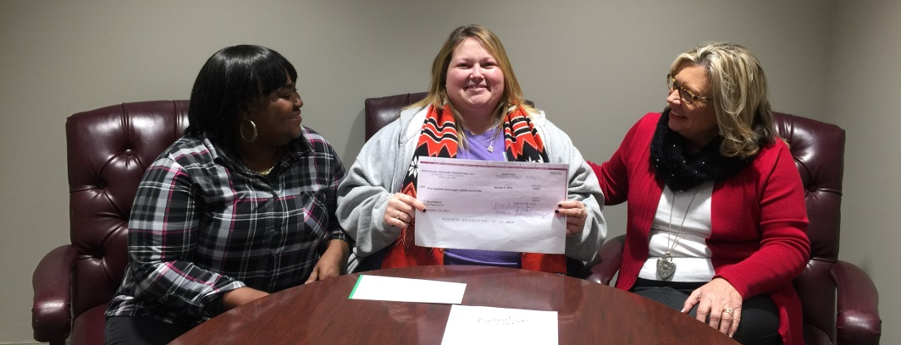
Winder Housing Authority’s Family Self Sufficiency (FSS) Program continues to graduate participants.
Two FSS graduates purchased homes in 2017.
In 2018 two graduates successfully completed their program and one will be purchasing a home in the coming year.

Slide 12
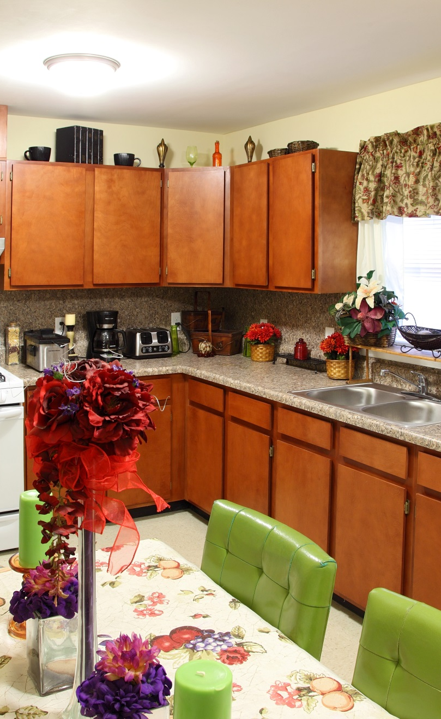
RAD Conversion Creates Improved Housing Conditions
$6MM rehabilitation of 322 affordable rentals – FHA 221(d)4
Public units converted to private under PBRA
Collaboration of private/public funds to improve efficiencies

Slide 13
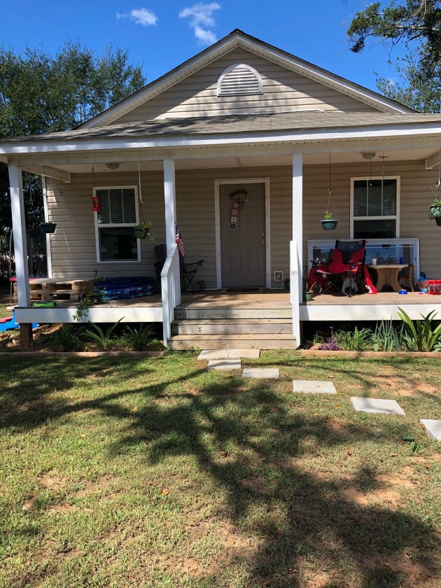
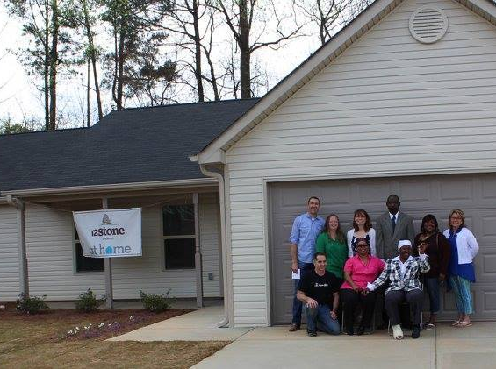
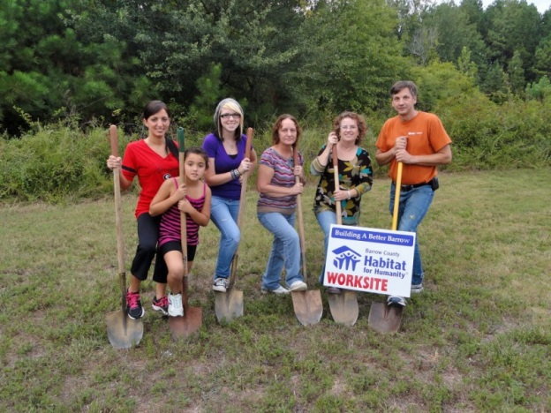

Habitat For Humanity
Several of our residents earned their home from Wimberly Center’s resident partner Habitat for Humanity.

Slide 14
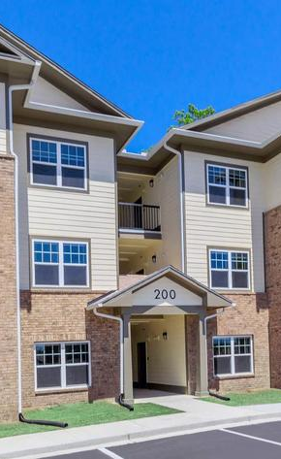
The Exchange Apartments
The Exchange, a brand new affordable housing community, is the ultimate in comfort and convenience. Located right off of University Parkway, they offer easy access to everything you need for work, school, shopping, and dining.

Slide 15
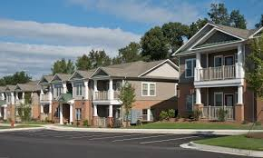
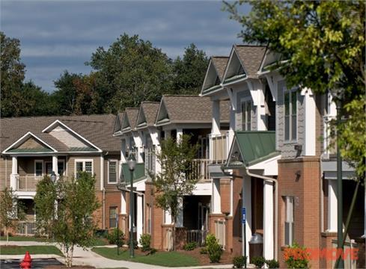
Farmington Hills Apartments
Farmington Hills is located just off of Hwy 316 in Winder, Georgia just minutes away from Target, Publix, Home Depot and Fort Yargo State Park.
This family community has great amenities such as a large clubhouse, large pool with a children’s splash center, covered pavilion, business center and a large pavilion for your weekend cook outs. In addition, each apartment home includes 9′ ceilings for spacious living, a microwave, washer/dryer connections, ceiling fans, cable internet ready connections and a beautiful front porch to enjoy the outdoors.

Slide 16

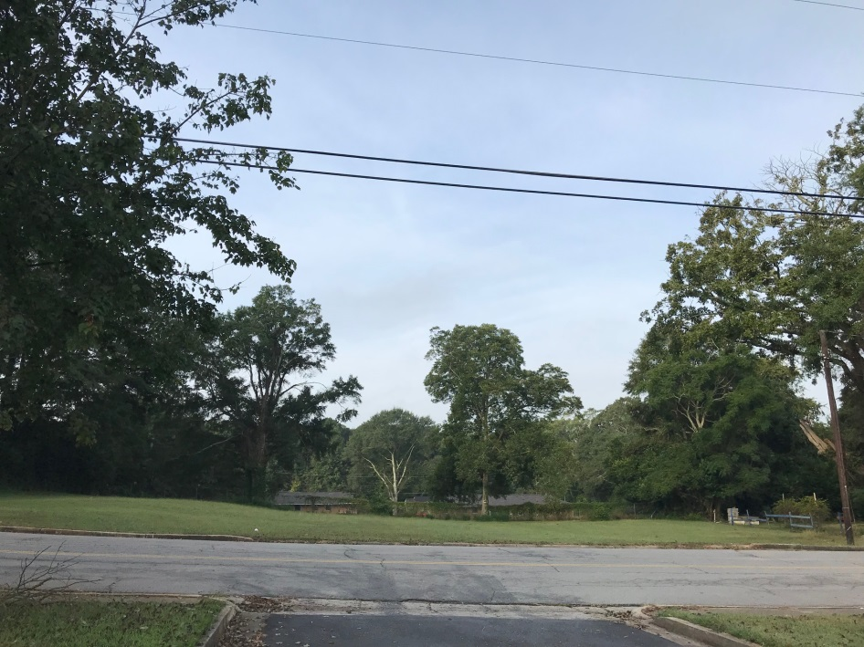
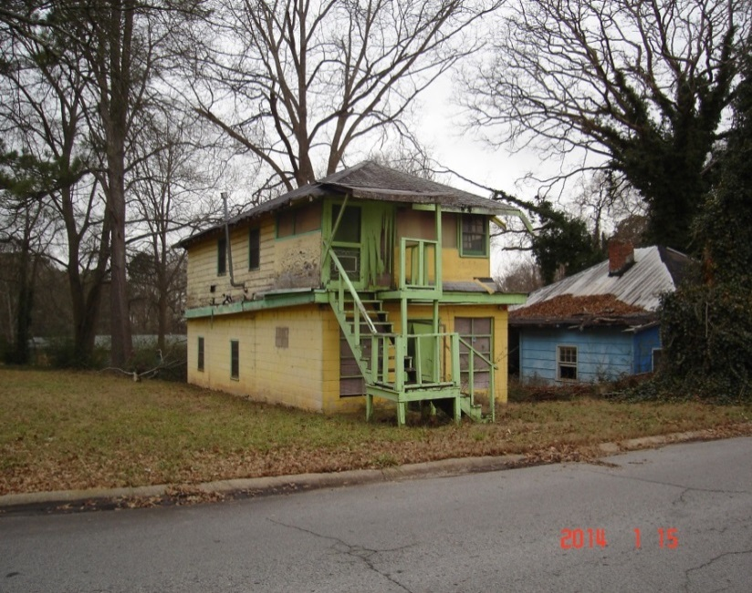

Code enforcement is key to revitalizing our neighborhoods. This is an example of how removing one unsafe dwelling can beautify an entire neighborhood.

Slide 17
For more information, contact Michelle Yawn, Winder Housing Authority Executive Director, at myawn@winderhousing.com

